Slide 1

Profane and sacred dimension of the
Islamic spatial practices: the case of everyday life in Mecca
Wiryono Raharjo
Department of Architecture
Faculty of Civil Engineering and Planning
Universitas Islam Indonesia
Email: raharjo@uii.ac.id

Slide 2
Profane / Sacred
The terms first coined by sociologist Emile Durkheim
Profane: the space of everyday life
Sacred: the space of religious practices
For muslim, the whole earth except graveyard and latrine has been made a place of prayer. So, we can convert any profane space (except graveyard and toilet) to sacred space immediately.

Slide 3
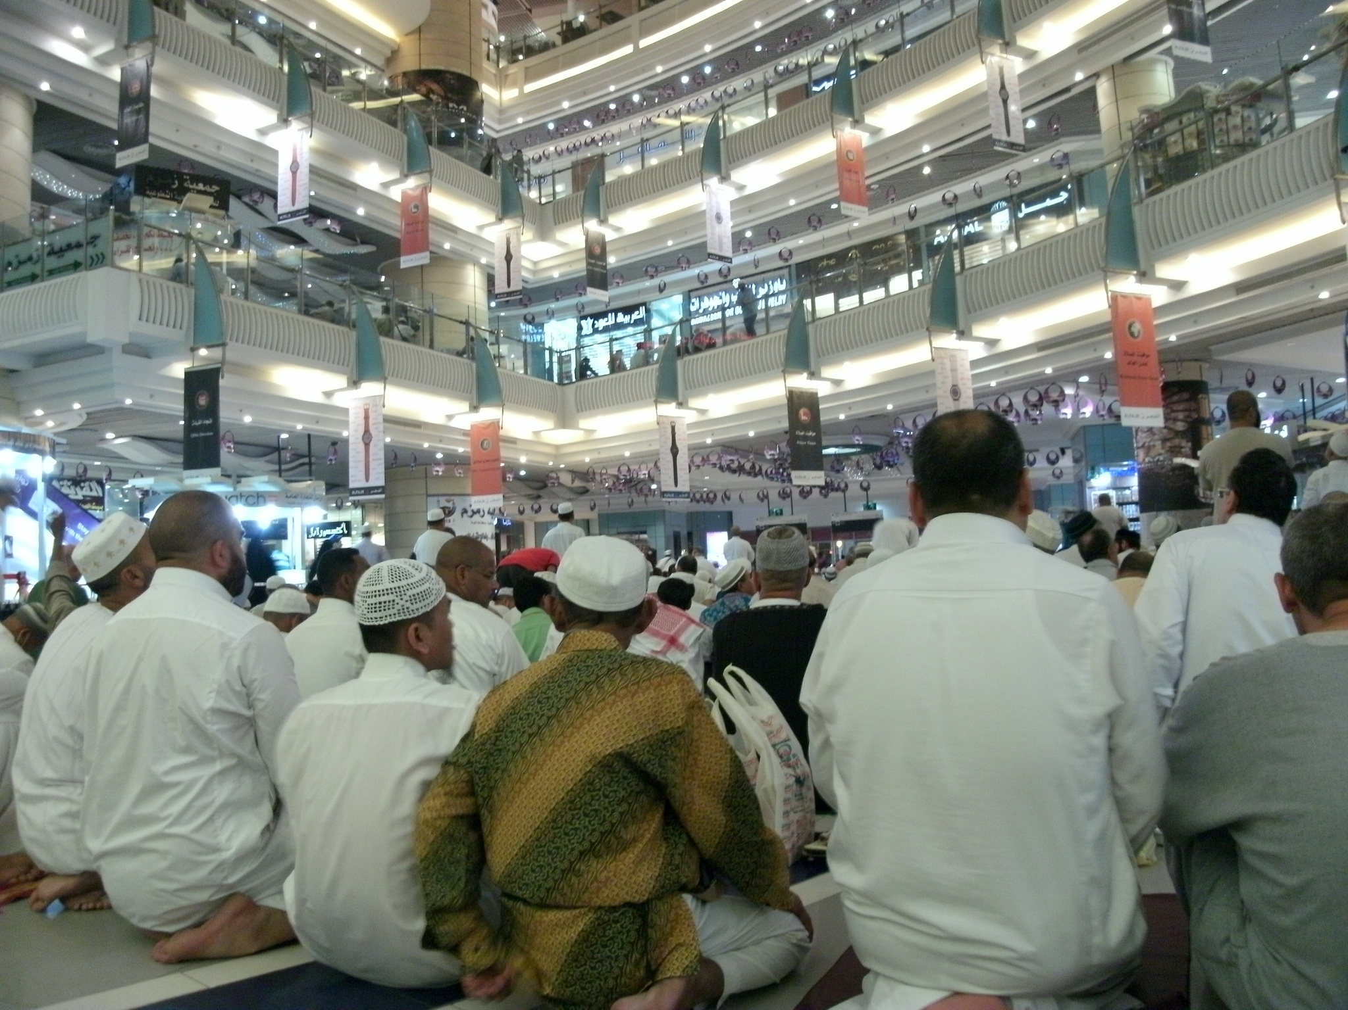
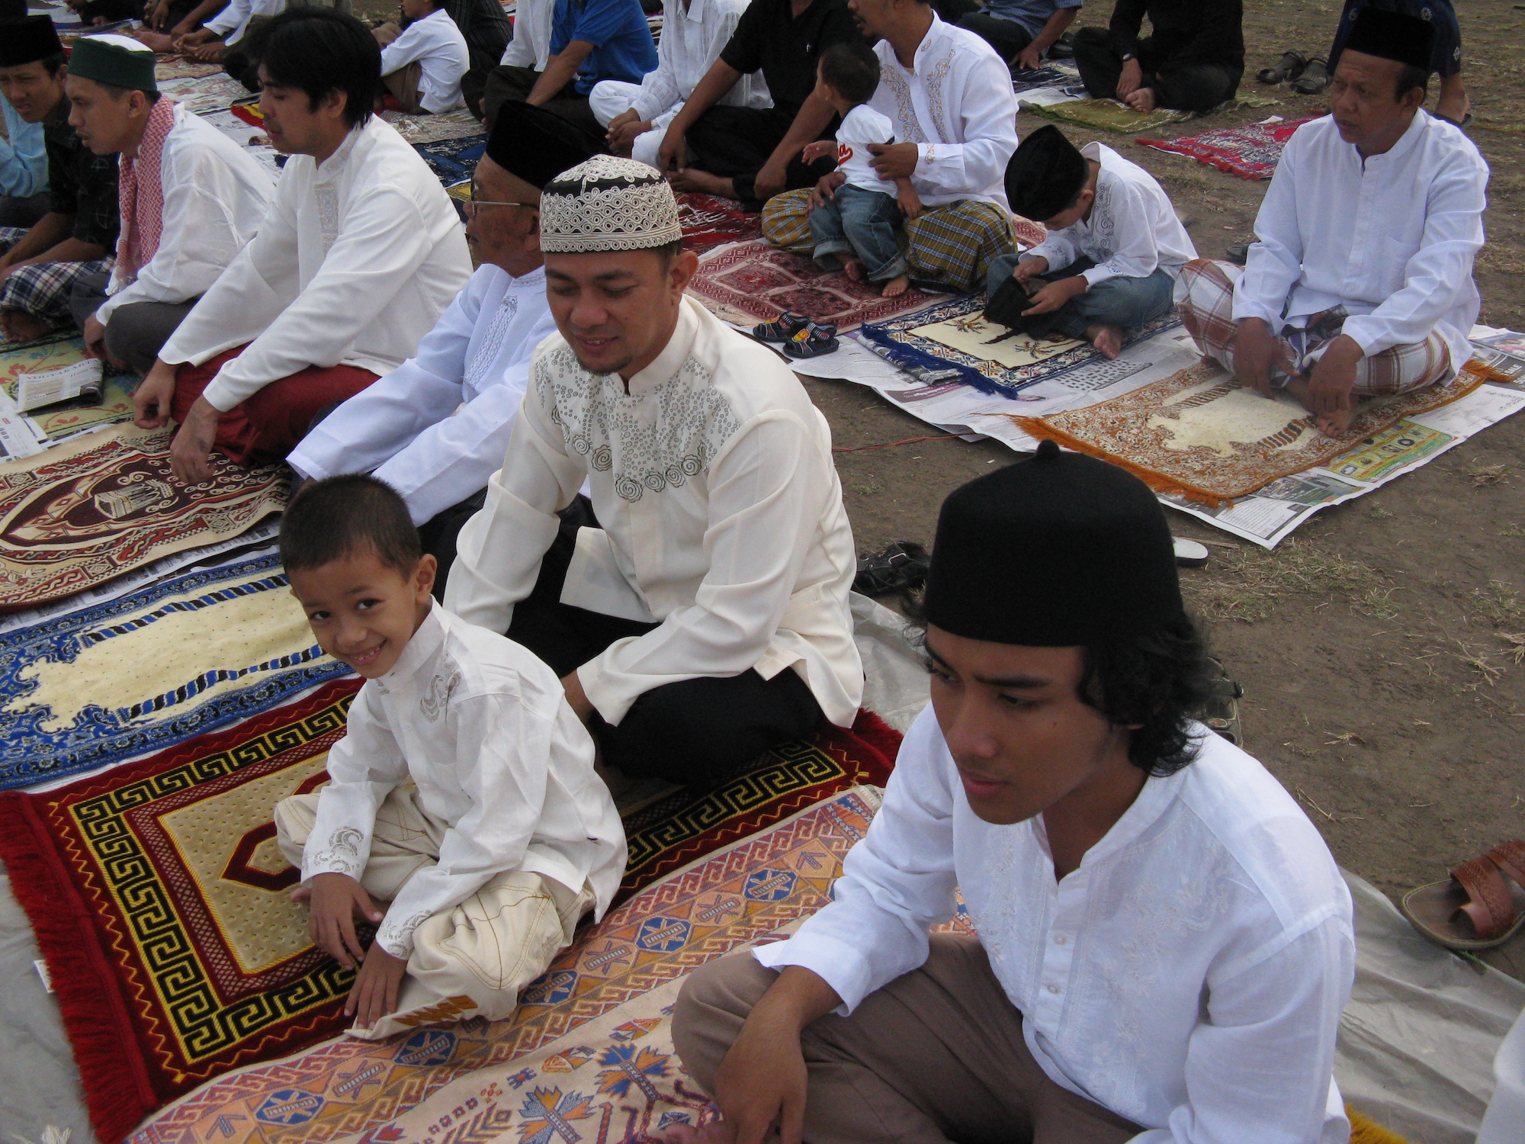
Eid prayer at the South Square of Yogyakarta (Indonesia)
Maghrib prayer inside a shopping
mall across the Al Haram Mosque in Mecca
(Saudi Arabia)

Slide 4
Smooth / Striated Space
The work of Deleuze & Guattari on smooth space and striated space can hep us understand the relationship between profane and sacred
Smooth space: nomad space, flexible, fluid
Striated space: sedentary space, the space instituted by the state
Smooth / striated space exist in mixture

Slide 5
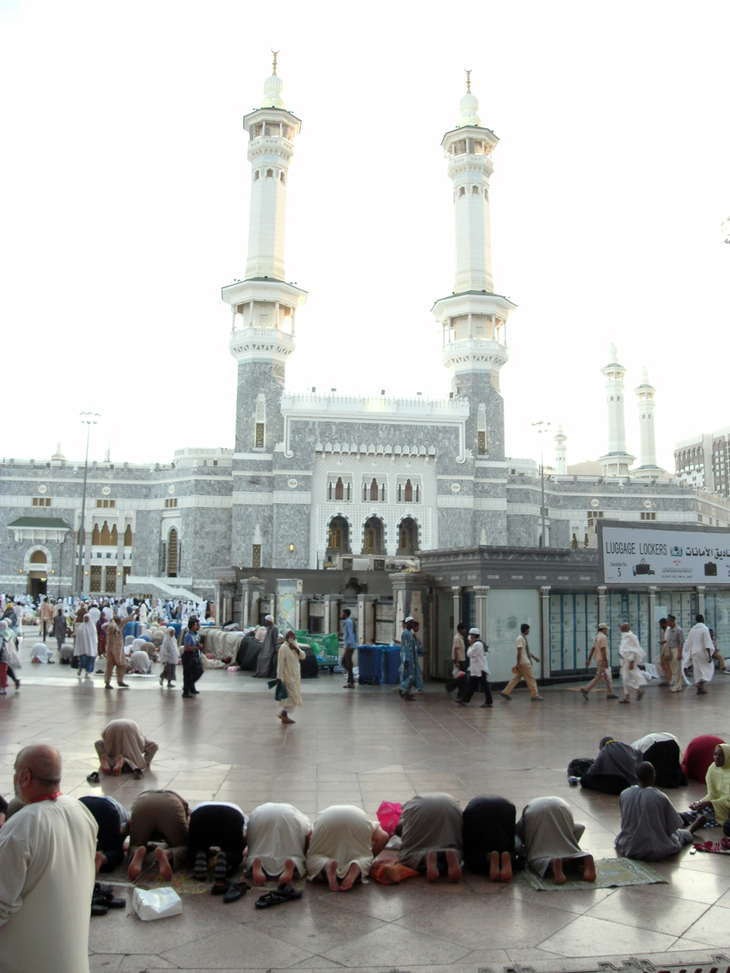
Profane / sacred: a mixture
The picture shows how an open space where part of public ‘profane’ (smooth) space suddenly changed into sacred (striated) space for prayer.
When the prayer finish, the sacred space turns to profane space again.

Slide 6
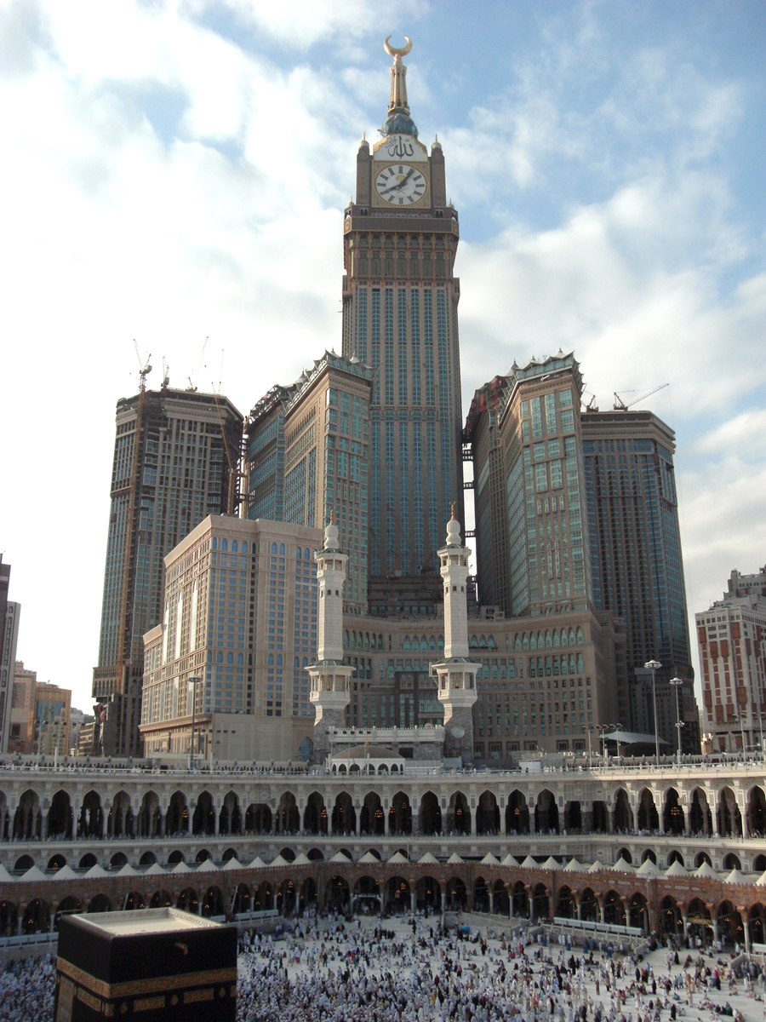
Profane?
Sacred?

Slide 7
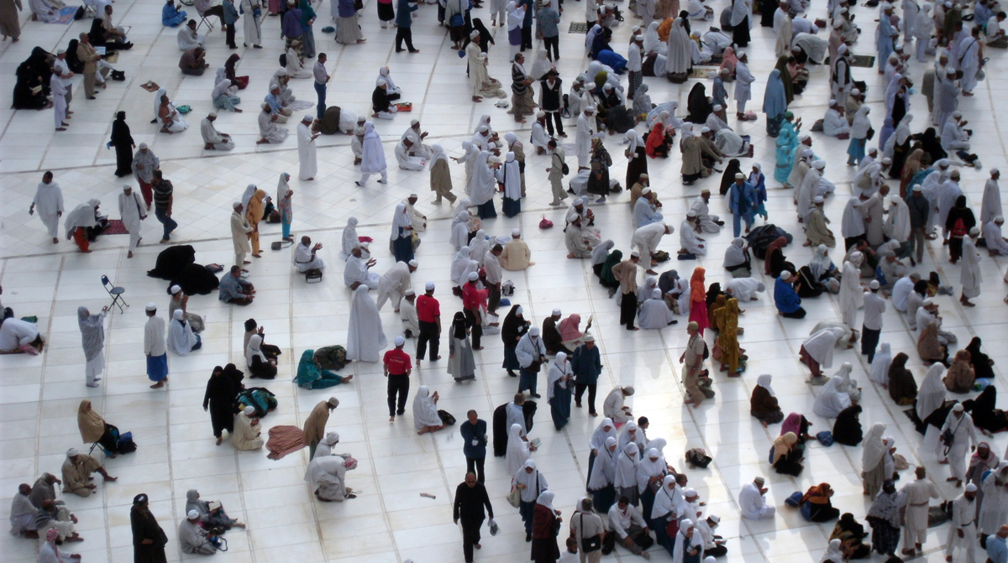

Slide 8
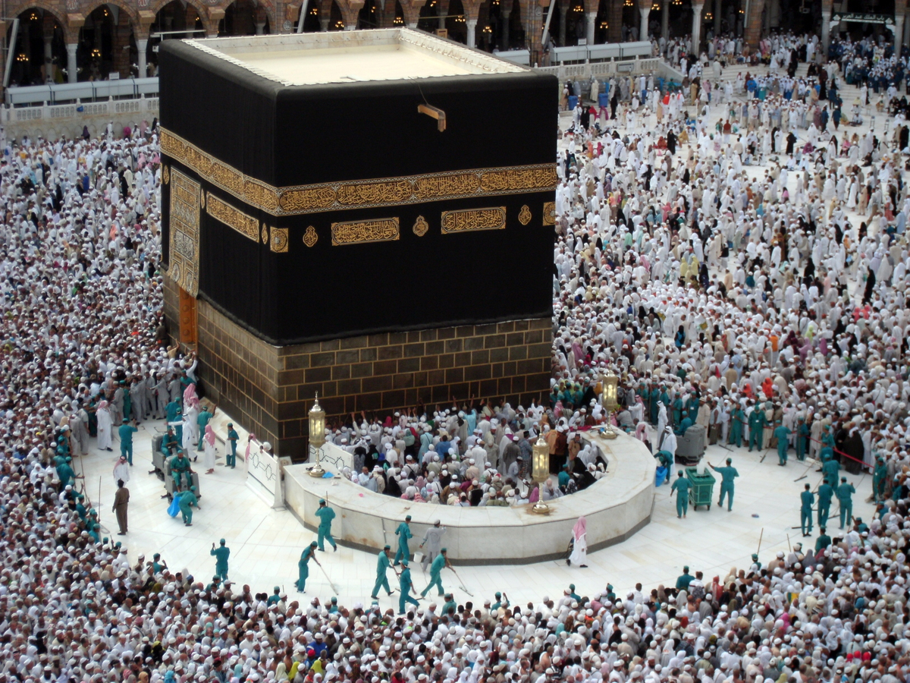
Profane Power?

Slide 9
Thank you

