Slide 1


Biodanza and a sense of resilience
in times of war
Dr. Gila Cohen Zilka (Ph.D) & Sylvie Tempel
Biodanza Israel
Zilka, C.G., & Tempel, S. (2024). Biodanza and a sense of resilience in times of war. Journal of Bodywork and Movement Therapies, 40, 2136-2146. https://doi.org/10.1016/j.jbmt.2024.10.054

Slide 2

Background
War affects many aspects and processes, and creates challenges for everyone, albeit in different ways for different individuals and populations.
Given the great importance of developing resilience and deepening the sense of self-efficacy during war, amidst a complex, unstable, and changing reality, a large-scale study was conducted in Israel in 2023 during the Iron Swords war.
The purpose of the present study was to examine what are the mechanisms of action in Biodanza that lead to an increase of resilience, affectivity, vitality, and morale in time of war.
2

Slide 3

Resilience
Resilience refers to an individual's capacity to cope and recover from challenging life experiences.
Resilience is understood as a conscious psychological coping process encompassing:
Physical dimensions
Psychological dimensions
Social dimensions
Like other internal resources, resilience develops through a dynamic process of growth and change, alongside relatively stable personal characteristics.
3

Slide 4

Theoretical Framework
To better understand the findings of this study, results were examined through the lens of Stueck's (2021) six Biocentric domains for protecting well-being.
Stueck, M. (2021). The pandemic management theory. COVID-19 and Biocentric development. Health Psychology Report, 9(2), 101-128. https://doi.org/10.5114/hpr.2021.103123
4

Slide 5

The purpose of the present study was to examine what are the mechanisms of action in biodanza that lead to an increase of resilience, affectivity, vitality, and morale in time of war.
Methodology
Mixed-methods research design.
Participants
N = 112 Biodanza practitioners
• 85 women (76%)
• 61 Biodanza facilitators (55%)
Biodanza experience ranged from 1 year to more than 15 years.
Mean experience:
7 years (SD = 5)
The mixed-methods approach allowed us to combine quantitative findings with rich qualitative descriptions of participants’ experiences.
https://docs.google.com/forms/d/e/1FAIpQLSdAuhTb1rKmcMHwCtrcBxI-EKGRkMm1M_1x44kt8Y9NONaKRw/viewform

Slide 6
Research tools
1. Demographic questionnaire that included 10 items such as: age and seniority at biodanza.
2. Closed questionnaires on resilience and coping based on the questionnaire of Steinberg, Brymer, Decker, and Pynoos (2004);
Vitality questionnaire of Bostic, Rubio, and Hood (2000);
Sense of belonging vs. alienation questionnaire by Sabatier and Berry (2010);
Motivation questionnaire of Pintrich, Smith, Garcia, and McKeachie (1991).
Respondents were asked to rate their agreement with each statement on a scale ranging from 1 (Not at all) to 5 (Very much).

Slide 7
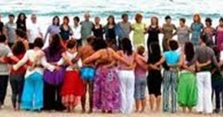
Findings
Biodanza During Wartime: Quantitative Findings
Key Results
Participants reported substantial benefits from Biodanza during the war:
Finding Agreement (%)
The human encounter in Biodanza positively affected 79%
Biodanza helped cope during the war 76%
Experienced increased affectivity and vitality during vivencias 63%
The quantitative findings indicate that Biodanza was perceived as a significant coping resource during wartime.

Slide 8
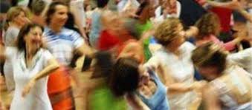
Theme 1: Human Encounter
Theme frequencies:
Illustrative Quotes
“Being together felt like being part of a supportive family.”
“The human encounter, the music, and the movement repeatedly renewed my strength.”
“I no longer felt alone; I felt part of a community.”
“Biodanza transformed my sense of helplessness and sadness.”
Theme | Mentions
Human connection | 98
Togetherness | 97
Support/Empathy | 91
Key message:
The interpersonal dimension emerged as the strongest resilience-promoting factor.

Slide 9
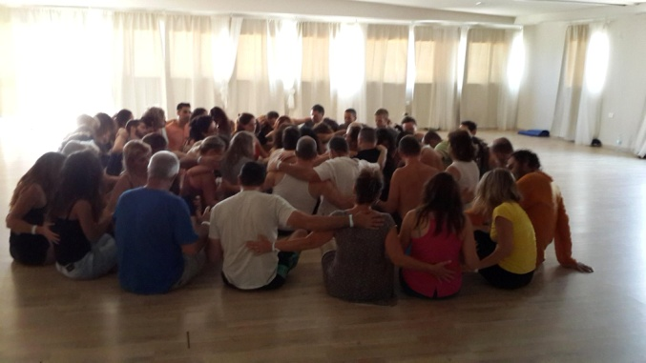
Human Connection as a Mechanism of Recovery
Diagram:
Human Encounter
Affectivity
Vitality
Hope & Morale
Resilience

Slide 10
Embodied Pathway to Recovery
Participants described a transition from:
Fear
Hypervigilance
Emotional freezing
Uncertainty
↓
Movement
Grounding
Synchronization
Emotional expression
↓
Regulation
Vitality
Social engagement
Interpretation
Biodanza may facilitate shifts from external threat monitoring toward internal regulation.
One of the most striking findings was the repeated description of a movement from psychological and physiological immobilization toward renewed engagement with life.

Slide 11

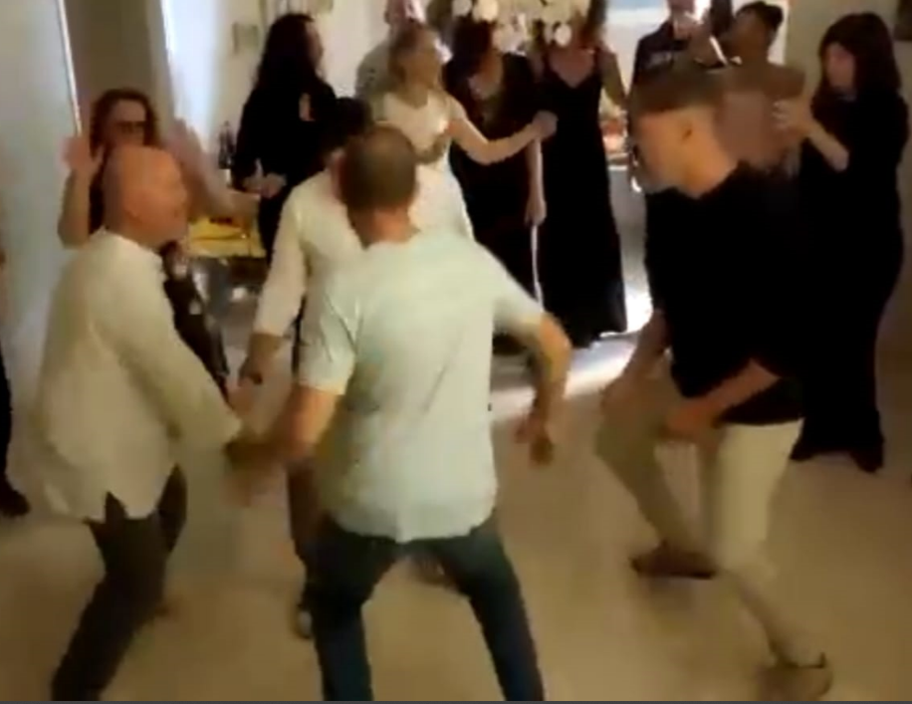
Physiological Regulation Through Movement
Frequently Reported Effects
Participants described:
• Release of muscular tension
• Reduced bodily contraction
• Increased vitality
• Greater physical flexibility
• Enhanced emotional expression
Key Themes
Theme Mentions
Bodily release 98
Vitality 86
"Letting go" 95

Slide 12
Biodanza Experience and Resilience
Quantitative Finding
The strongest predictor of resilience was:
Years of Biodanza Practice
Participants with more years of practice reported:
Higher resilience
Better emotional regulation
Smaller wartime decline

Slide 13
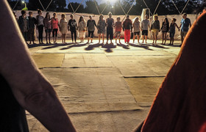
Biodanza and the Six Biocentric Domains
Theoretical Framework
To better understand the findings, results were examined through the lens of Stueck's (2021) six biocentric domains for protecting well-being.

Slide 14

Domain 1: Maintaining Affective Communication
Participants emphasized:
• Hugs
• Eye contact
• Touch
• Empathy
• Compassion
• Human warmth
Interpretation
Affective communication emerged as a central resilience-promoting factor.
Many mentioned eutony practices as exercises that evoked empathy, solidarity, and compassion, and helped them deal with the sudden and intense shock and with the feelings of pressure.

Slide 15

Domain 2: Maintenance of lively corporeality
Participants reported:
• Increased vitality
• Bodily activation
• Grounding
• Movement integration
• Improved regulation
Interpretation
Embodied experiences appear to support psychological well-being during crisis.
The body was repeatedly described as a pathway toward resilience.

Slide 16
Domain 3: Contact with one’s own identity and inner oriented self-reflexion together with others
Self-Awareness, Self-Efficacy, and Communication
Participants reported:
• Greater self-awareness
• Increased self-efficacy
• Improved emotional regulation
• Better communication with others
Interpretation
Biodanza may strengthen adaptive self-regulatory capacities.

Slide 17
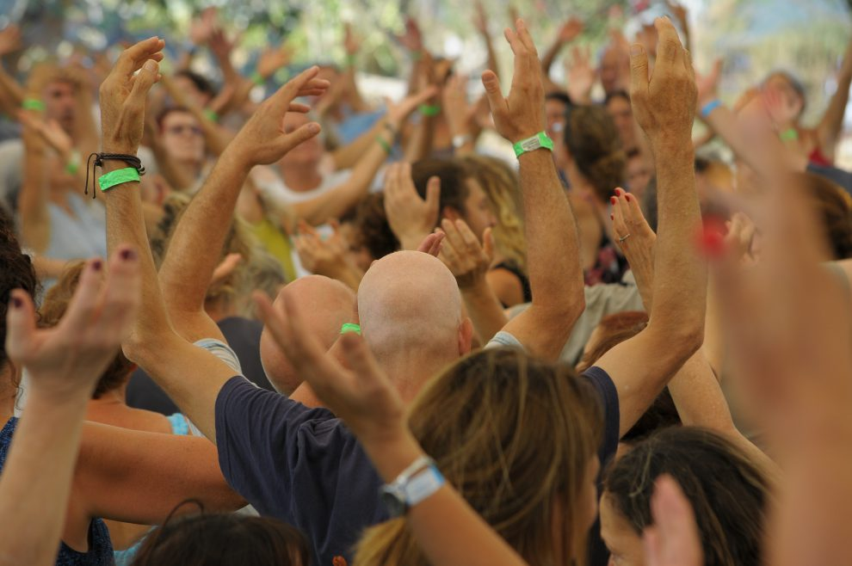
Domain 4: Meaning and Life Potential
Participants described:
• A renewed sense of meaning
• Increased autonomy
• Hope
• Motivation
• Enhanced morale
Interpretation
The findings suggest that Biodanza may support existential resilience during adversity.
Participants often described reconnecting with what matters most in life.

Slide 18
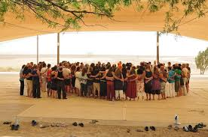
Domain 5: Expansion of Consciousnes
Participants reported:
• Renewed optimism
• Broader perspectives
• Increased courage
• Greater awareness of personal strengths
Interpretation
Movement experiences may facilitate cognitive and emotional flexibility.
Many participants described shifts in perspective and renewed hope.

Slide 19
Domain 6: Biocentric Lifestyle and Belonging
Participants emphasized:
• Participation
• Community involvement
• Identity
• Belonging
• Self-worth
Interpretation
The findings support the role of community belonging as a protective factor during crisis.
Belongingness consistently emerged as one of the strongest resilience resources.

Slide 20
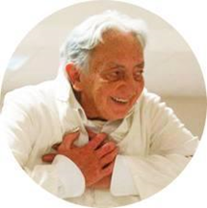
Integrative Model: How Biodanza Promotes Resilience During Wartime
Proposed Mechanism
Embodied Movement
↓
Physiological Regulation
↓
Emotional Release
↓
Interpersonal Connection
↓
Sense of Belonging
↓
Hope and Meaning
↓
Resilience

Slide 21
A Model for vivencias in Times of War and Crisis
At each stage, a number of vivencias are adjusted according to the well-being of the group
Stage 1 - Releasing Movement
Stage 2 - Releasing Emotions
Stage 3 - Feeling of Security
Stage 4 - Resilience and Rebirth

Slide 22
Stage 1 - Releasing movement, reconnecting with the body with affectivity
Stage 1
Movement release. Reconnect with the body in an affectivity and loving way. Regulate the nervous system with music and movement. Increase vitality.
Ground contact, crawling and rolling movements, shaking, gentle tactile exercises, synchronization, walking, walking in pairs. | Recommended Exercises
IBF07 – 14 Appel des esprits; IBF19 - 02 Down In Belgorod; IBF07 - 02 Missa Luba. Kyrie; IBF07 - 01 La vie en rose [Part]; IBF07 - 06 When You're Smiling. | Music
These experiences appear to restore:bodily awareness, sense of safety, connection to the environment. The body a source of psychological stabilization

Slide 23
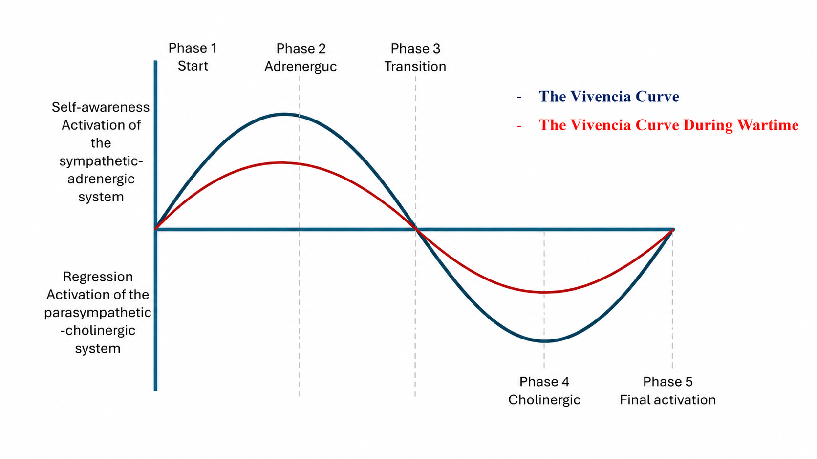

Slide 24
Stage 2 - Releasing emotions with affectivity
Stage 2
Releasing emotions with affectivity. Releasing emotions without words. Moving, getting out of the Paris state. Calling for a space that allows for being together.
Grounding exercises, earth-element exercises, slow walking, dyadic synchronization, opening the chest and arms. Circle with quiet, affectivity music. | Recommended Exercises
IBF01 - 20 – Adagio; IBF01 - 07 - Ballad Of Sir Frankie; IBF01 - 06 - Behind That Locked Door; IBF02 - 07 I'd Have You Anytime | Music
The Vivencia curve goes up a little. No games or fun exercises. | Notes
These practices may support autonomic nervous system regulation by reducing physiological hyperarousal and restoring a sense of stability.

Slide 25
Stage 3 - Feeling confident
Stage 3
A safe environment that inspires trust in ourselves and others.
Mutual holding, eutony exercises, touch, eye contact, group support, walking with determination, expressive dance, yang, rhythmic, flow dance with sphere of protection, cradle Circle. | Recommended Exercises
IBF11 - 09 kitaro; IBF09 - 03 - Zamfir, Gheorghe – Bilitis; IBF11 - 09 - Kitaro - Earth Born; IBF09 - 15 - The Light Thas Has Lighted The World. | Music
Most of the exercises are still with eyes open, slowly offering exercises with eyes closed to strengthen trust in others, such as the Guardian Angel exercise. | Notes
These findings suggest processes of interpersonal co-regulation, in which emotional states are regulated through safe social interactions.

Slide 26
Stage 4 - Resilience
Stage 4
To inspire a sense of hope, self-esteem, and a desire to return to functioning.
Rhythmic activation, enhanced motor impulse, physical and mental expansion exercises, group flow, flying as a flock. | Recommended Exercises
IBF08 – 14 Europa; IBF08 - 18 In A Sentimal Mood; IBF08 - 17 Love Theme; IBF12 - 16 Someone To Watch Over Me; IBF08 - 20 Theme From Taxi Driver; IBF08 - 19 You Don't Know Me. | Music
To inspire a sense of hope for a better future. | Notes
Movement appeared to reactivate vitality and engagement with life.
Vitality emerged not merely as energy but as a renewed willingness to participate in life.

Slide 27
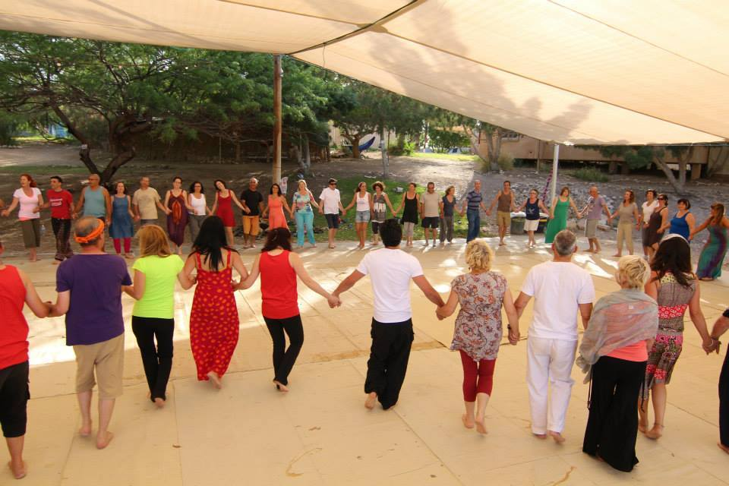
Thanks for listening

